Slide 1
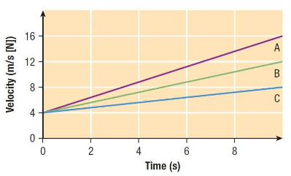
Warm Up
a) How can you tell that each object has a uniform acceleration, but not a uniform velocity?
b) What is each acceleration?
c) Which object travelled the greatest distance? Explain.
Notes:
This acceleration is caused by a force. If all three objects were identical, we would be able to conclude that object A had the most force applied to it because it had the greatest acceleration (force is proportional to acceleration)

Slide 2
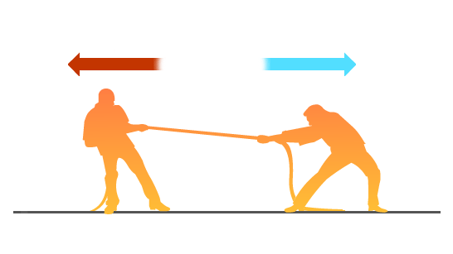
Introduction to Dynamics
Notes:
http://phet.colorado.edu/en/simulation/forces-and-motion-basics

Slide 3

What is a Force?
$$\vec{F}$$
A force is a push or pull on an object that may result in:
Acceleration
Compression
Stretching
Twisting
Stabilizing
Deformation
Each force is a VECTOR quantity meaning it has a MANGITUDE, UNIT, and a DIRECTION
Notes:
The unit for force is the Newton, where 1 N = 1 kg m/s²
Where acceleration can cause a change in direction, speed, or both!

Slide 4
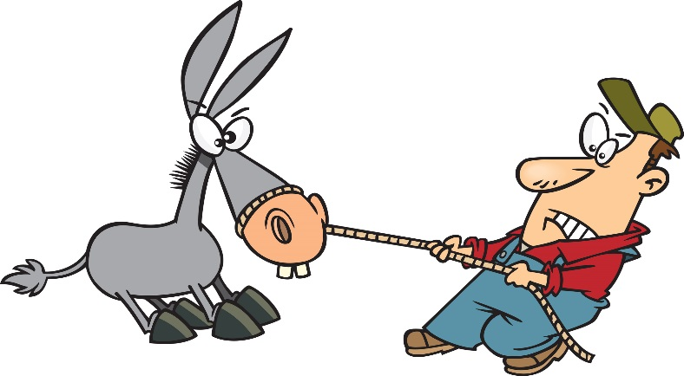
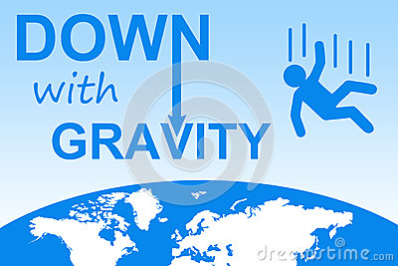
What Experiences a Force?
This “push or pull” occurs between two objects.
One object must create the force
One object must experience (“feel”) the force
Contact Forces
Non-contact Forces

Slide 5
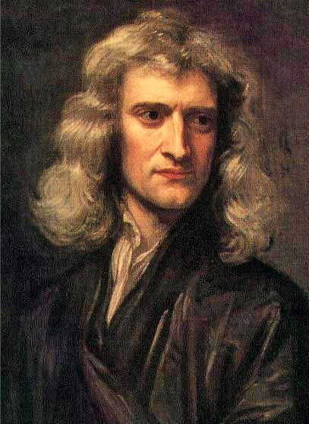
Even More about Forces?
Forces are vector quantities that are measured in Newtons
1 N = 1 kg m/s²

Slide 6
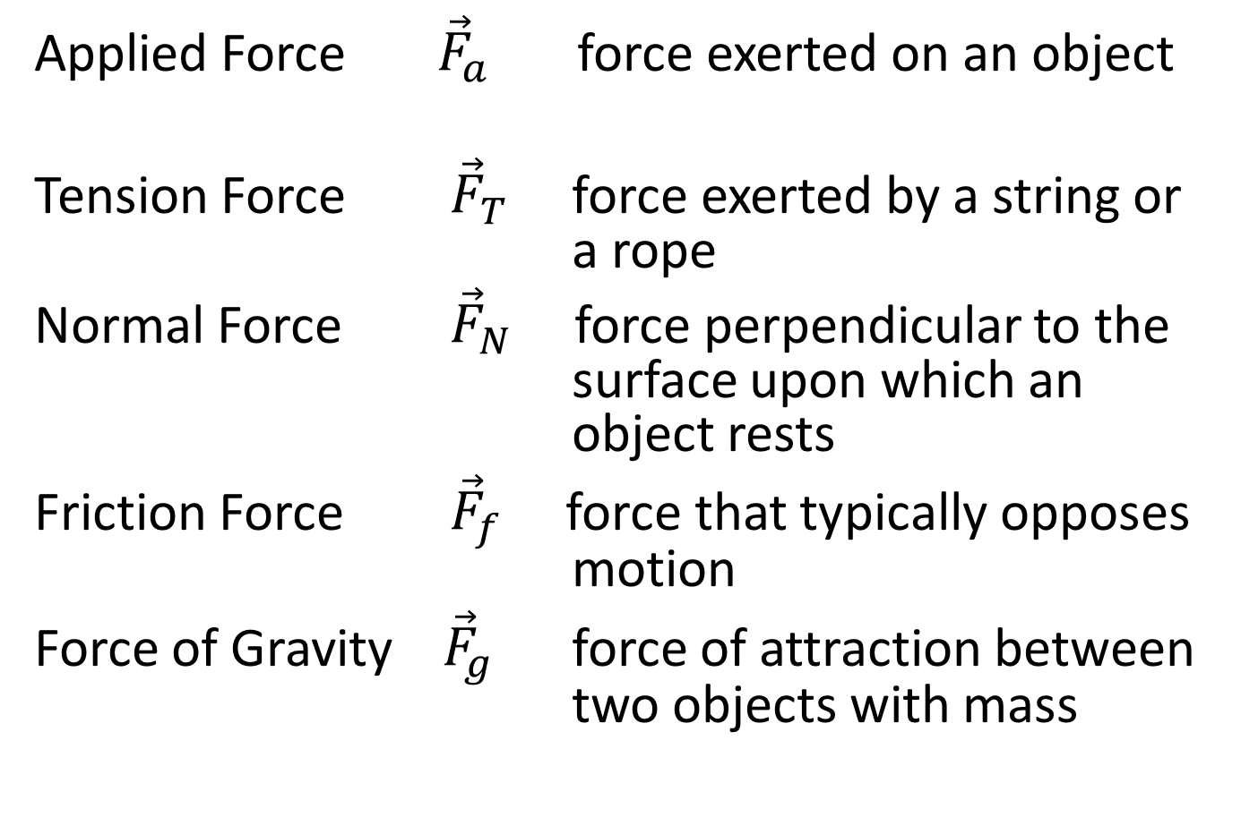
Types of Forces
Applied Force ${\vec{F}}_{a}$ force exerted on an object
Tension Force ${\vec{F}}_{T}$ force exerted by a string or a rope
Normal Force ${\vec{F}}_{N}$ force perpendicular to the surface upon which an object rests
Friction Force ${\vec{F}}_{f}$ force that typically opposes motion
Force of Gravity ${\vec{F}}_{g}$ force of attraction between two objects with mass
Notes:
These are our most common forces that we will be dealing with this year, aside from gravity, all other forces are contact forces (meaning two objects must be touching in order for the force to occur)

Slide 7
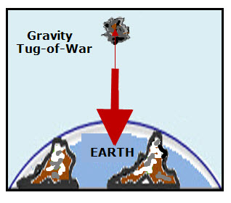
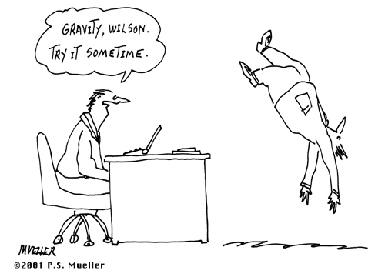
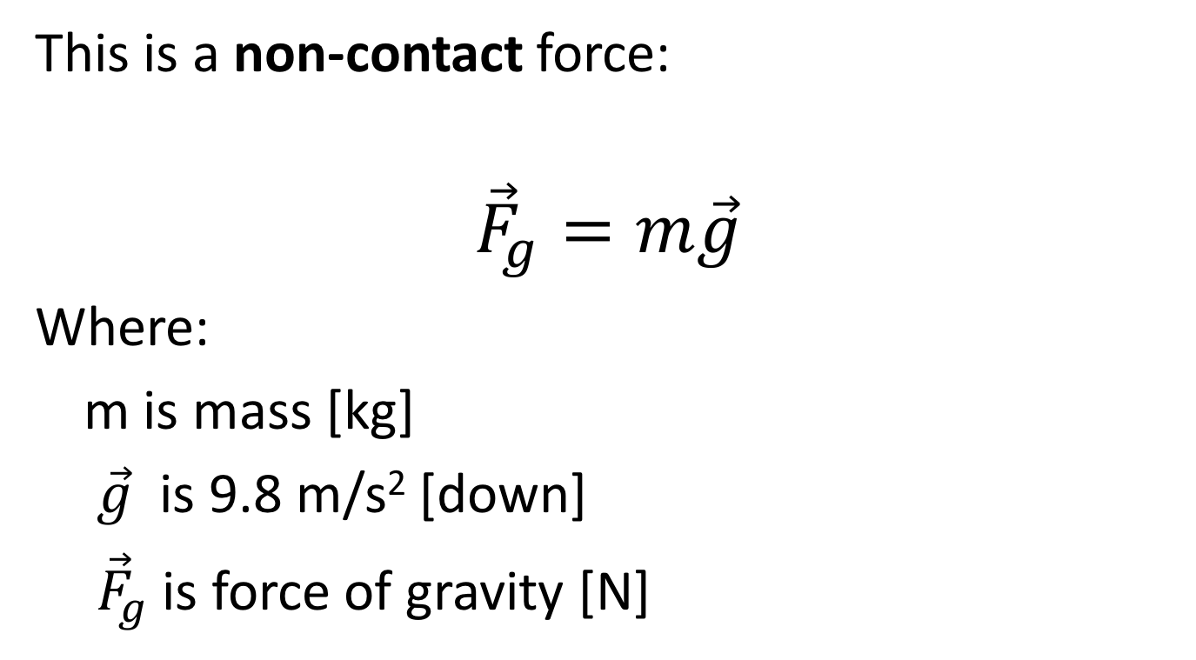
Force of Gravity
This is a non-contact force:
$${\vec{F}}_{g}=m\vec{g}$$
Where:
m is mass [kg]
$\vec{g}$ is 9.8 m/s² [down]
${\vec{F}}_{g}$ is force of gravity [N]
Notes:
This is a great way to remember how the derived unit of a Newton is defined.

Slide 8
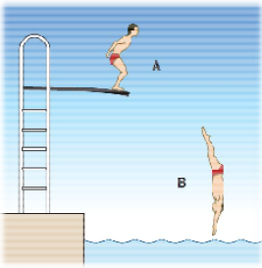
Example
What forces are acting on the diver at each point?
Notes:
A: upward normal force and downward force of gravity
B: downward force of gravity (and technically upward air resistance which is wind friction)

Slide 9
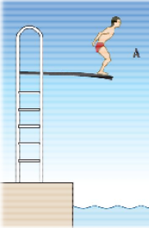

Analyzing Forces - System Diagrams -
System Diagrams show all the objects involved in a situation
What might be the:
Advantages?
Disadvantages?
Notes:
These diagrams help you visualize the situation

Slide 10
Analyzing Forces - Free Body Diagrams (FBD) -
Simplified diagrams that show the object and any external forces acting ON THAT OBJECT
i) The object is represented by a dot
ii) The forces all start on the object and point outwards (ie. NOT ready for vector addition)
iii) Each force is labeled with an appropriate symbol
Notes:
The dot represents the centre of mass of the object that we are analysing

Slide 11
Analyzing Forces - FBD Example -
Do you think the length of each arrow is important?
Explain.
Notes:
These diagrams help you visualize the situation

Slide 12
Balanced vs. Unbalanced Forces
If all the forces on an object are balanced the object is not accelerating
We call this equilibrium → static
→ dynamic
If the forces on an object are unbalanced then there is an overall force causing the object to accelerate
Notes:
We can see this in the simulation: http://phet.colorado.edu/en/simulation/forces-and-motion-basics (Acceleration Lab)
What type(s) of motion would be classified as ‘not accelerating’???

Slide 13
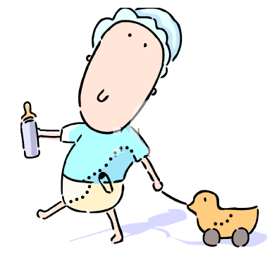

Example
Draw a FBD for each of the following:
a) Book at rest b) duck accelerating
to the left

Slide 14
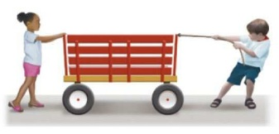
Challenge:
Draw a FBD for the wagon below, assuming:
It is accelerating to the right
It is not moving
It is moving with a constant velocity

